Slide 1
Gender Determination

Slide 2
Sex Determination
In humans what genetically makes you male or female????
Images from: http://www.careerwomaninc.com/blog/?p=1675

Slide 3
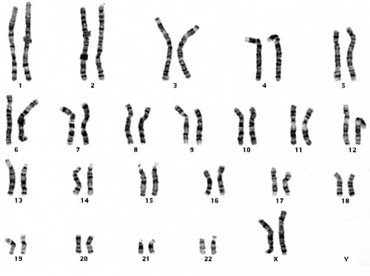
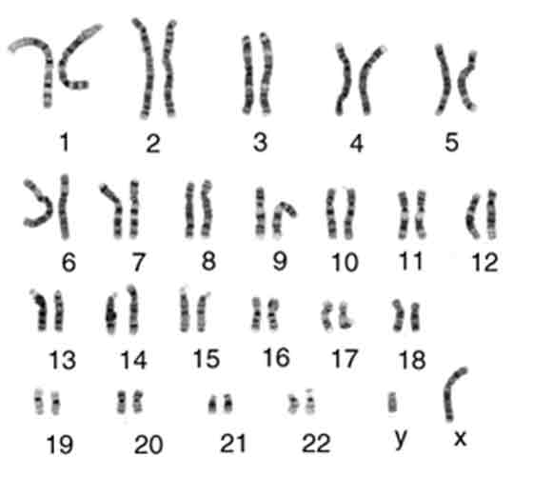
Gender is determined by our chromosomes
females → XX
males →XY
female
male
What can you notice about the difference between the X and Y chromosomes?

Slide 4
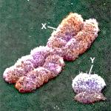
What do you notice about the difference
between the X and Y chromosomes?
Y chromosome is much smaller.
The Y chromosome carries the “SRY” gene. This gene is called the “sex-determining gene” because it causes male sex organs to develop.
SRY
Images from: http://creationrevolution.com/2011/01/y-chromosome-adam-and-the-cambrian-explosion/

Slide 5
The possible genotypes for gender are XX or XY.
That amounts to 3 Xs and 1 Y.
Why then aren’t there more females than males in the world?
→ Complete the Punnett square
X
X
Results:
Each mating there is a
50% chance female and
50% chance male
X
XX
XX
Y
XY
XY

Slide 6
Do Now: Take out homework. 1. What types of RNA are involved in protein synthesis? 2. How many nitrogenous bases are in one codon? 3. How many codons are needed to specify 2 amino acids?
5/7/2014
Homework: Study for DNA core assessment (repication, transcription, and translation) and genetics/cell divison test

Slide 7
Match the RNA with its description:
______ mRNA ______ tRNA ______ rRNA | a. brings the amino acid to the complementary codon b. allows the DNA sequence to leave the nucleus c. is bound to the ribosome and assists in making proteins

Slide 8
Do Now: Take out homework. Then… What is the difference between a codon and an anticodon? Write in the anticodons for this strand of mRNA.
5/8/2014
Homework: Study for DNA core assessment (repication, transcription, and translation) and genetics/cell divison test

Slide 9
Fill in the following chart:
DNA | mRNA (codon) | tRNA (anticodon) | Amino acid (abbrev)
TAC
GAT
CCA
GTT

Slide 10
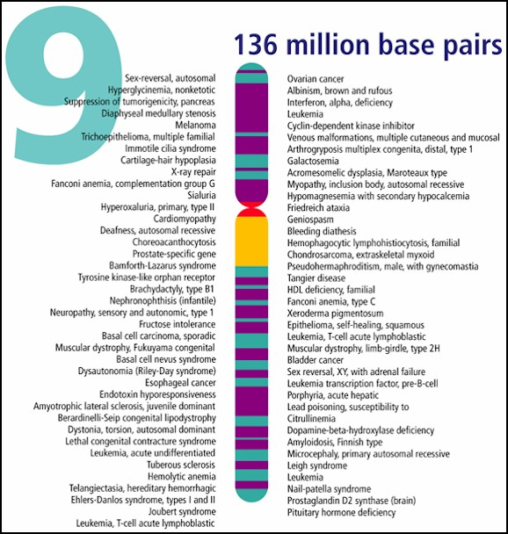
Human Genetic Disorders
Images from: http://www.dnarss.com/Chromosome_9.html

Slide 11
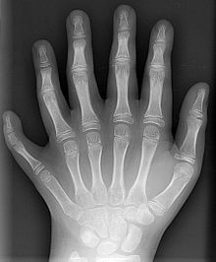
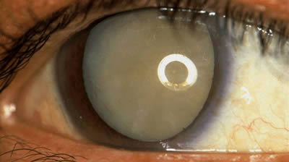
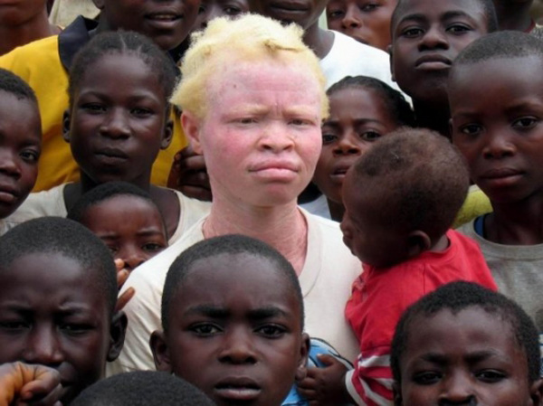
Genetic Traits and Disorders
Genes that control human traits can be altered (mutated) and then be inherited by offspring
Images from: http://www.aldanaanatomy.com/category/skin/page/2/, http://www.eyesurgeonspc.com/lasik-rock-island/cataract_surgery_rock_island/cataract-surgery-rock-island.html, http://en.wikipedia.org/wiki/Polydactyly

Slide 12
Question:
What is a mutation?

Slide 13
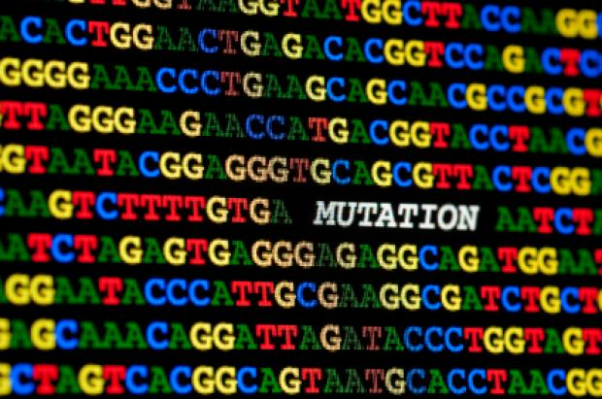
Mutation
Definition= a change in DNA sequence that affects genetic info
NOTE = The result of some mutations are genetic disorders, not all!
Image from: http://alsn.mda.org/news/c9orf72-mutation-most-common-cause-als-ftd-als-ftd

Slide 14
How are disorders passed or inherited?
Four main ways
Single gene
Multifactorial
Chromosomal abnormality
X-linked

Slide 15
1. Single Gene Disorders
The problem trait is controlled by a single gene and can be passed in a dominant/recessive manner.
Examples . . .

Slide 16
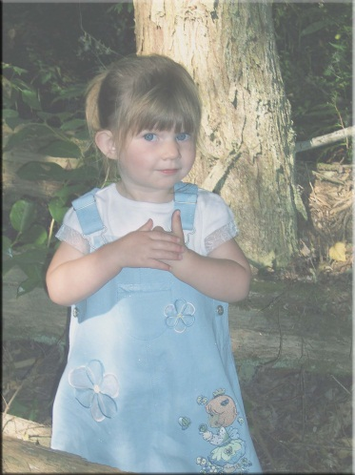
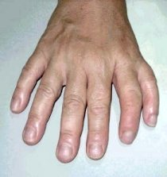
Single Gene Disorders (examples)
Dominant
Achondroplasia
2. Cataracts
3. Polydactyly
Images from: http://www.tvchannelsfree.com/tvshows/232/Little-People--Big-World/3.html, http://www.avclinic.com/Cataract.htm http://www.beltina.org/health-dictionary/polydactyly-extra-fingers-toes.html

Slide 17
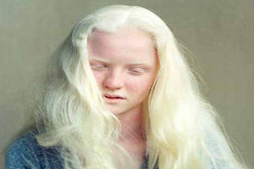
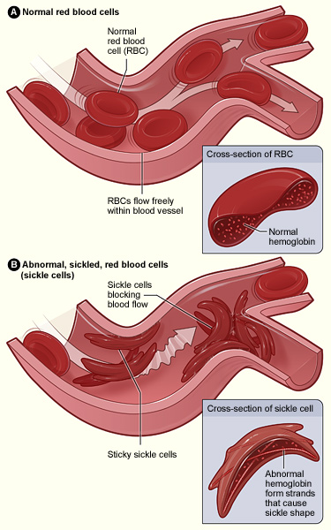
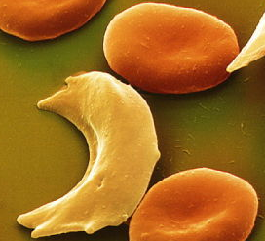
Single Gene Disorders (examples)
Recessive
Albinism
2. Sickle Cell Anemia
Images from: http://vitiligorelief.com/albinism-in-humans.html, http://www.albinism.org/, http://www.sciencephoto.com/images/download_lo_res.html?id=771080393, http://www.nhlbi.nih.gov/health/health-topics/topics/sca/

Slide 18
2. Multifactorial Disorders
many
factors
These disorders result from mutations in multiple genes
Environmental factors can also affect the severity/onset of these disorders
Difficult to study and treat

Slide 19
Multifactorial Disorders (examples)
Examples . . .
Hypothyroidism
Alzheimer’s disease
Some cancers (colon, breast,etc)

Slide 20
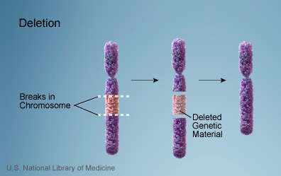
3. Chromosomal Abnormality
In these disorders entire chromosomes or large segments of chromosomes are missing, duplicated, or otherwise altered.
Image from: http://ghr.nlm.nih.gov/handbook/illustrations/chromosomaldeletion

Slide 21
Ways chromosomal abnormality can occur:
Nondisjunction
Failure of a chromosome to separate from its homologue during meiosis
One gamete receives an extra copy of a chromosome and the other gamete lacks the chromosome entirely

Slide 22
Nondisjunction

Slide 23
Simulation: Demonstrates mistakes in meiosis (click on image)
Nondisjunction
Video found at: http://www.sumanasinc.com/webcontent/animations/content/mistakesmeiosis/mistakesmeiosis.html

Slide 24
Utah Genetics simulation of how Monosomy/Trisomy develop (click on image)
Nondisjunction
http://learn.genetics.utah.edu/content/begin/traits/predictdisorder/

Slide 25
Chromosomal Abnormality (cont.)
Scientists can use karyotypes to identify disorders caused by chromosomal abnormalities.
Example of a normal human male karyotype:

Slide 26
Nondisjunction
Ex. Down Syndrome is caused by three copies of chromosome # 21
Image from: http://learn.genetics.utah.edu/content/disorders/whataregd/down/

Slide 27
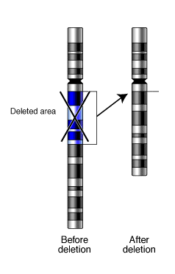
deletion
Ways chromosomal abnormality can occur:
Image from: http://members.cox.net/amgough/Fanconi-genetics-genetics-primer.htm

Slide 28
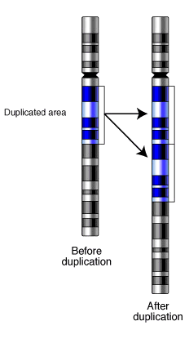
duplication
Ways chromosomal abnormality can occur:
Image from: http://members.cox.net/amgough/Fanconi-genetics-genetics-primer.htm

Slide 29
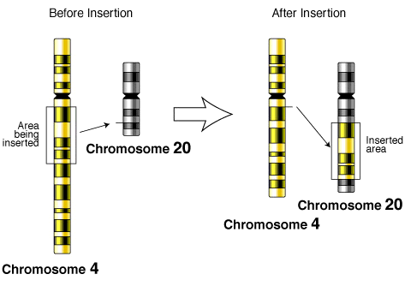
insertion
Ways chromosomal abnormality can occur:
Image from: http://members.cox.net/amgough/Fanconi-genetics-genetics-primer.htm

Slide 30
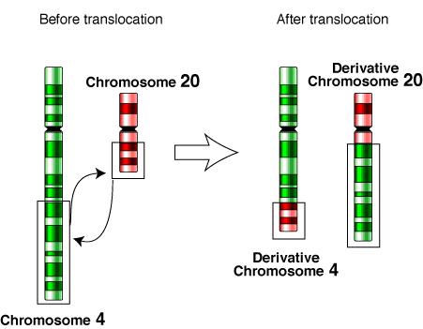
translocation
Ways chromosomal abnormality can occur:
Image from: http://members.cox.net/amgough/Fanconi-genetics-genetics-primer.htm

Slide 31
Checkpoint: Analyze Karyotypes
Human?
Male or Female?
Genetic Disorder?
Image from: http://www.biotechnologyonline.gov.au/popups/img_karyotype.html

Slide 32
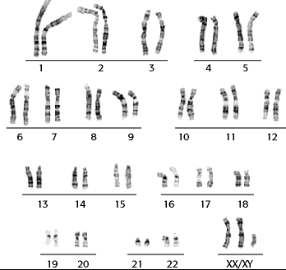
Checkpoint: Analyze Karyotypes
Human?
Male or Female?
Genetic Disorder?
Image from: http://www.biology.arizona.edu/human_bio/problem_sets/human_genetics/11t.html

Slide 33
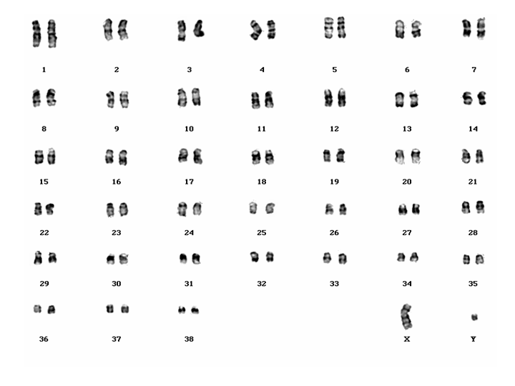
Checkpoint: Analyze Karyotypes
Human?
Male or Female?
Genetic Disorder?
Image from: http://www.humangenetik.uni-bremen.de/HundegenetikEng.html

Slide 34
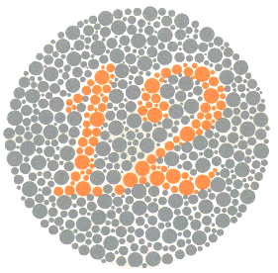
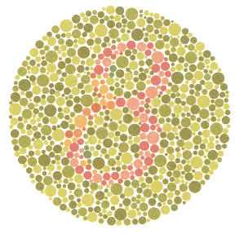
Disorders in which the mutation or errors are in genes found on the X chromosome
4. X-Linked Disorders
Examples . . . 1. Hemophilia 2. Muscular Dystrophy 3. Red/green colorblindness
Images from: http://www.colour-blindness.com/colour-blindness-tests/ishihara-colour-test-plates/

Slide 35
Genetic
Disorders
Jigsaw Activity
Images from: http://learn.genetics.utah.edu/content/disorders/whataregd/

Slide 36
Pedigree: Studying genetic disorders in humans
It is unethical to use humans as test subjects (plus it would take too long to get the results), thus one of the best ways to study human patterns of inheritance is to use . . .
Pedigrees!
Image from: http://faculty.ucc.edu/biology-atsma/misc/gen2004.htm

Slide 37
Pedigree:
A family tree that traces the inheritance of a specific trait.

Slide 38
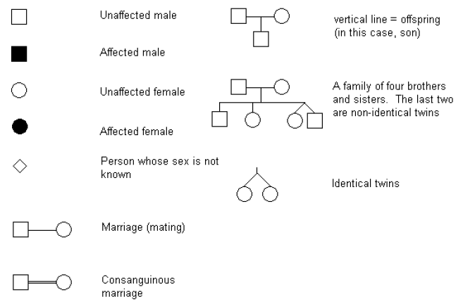
Pedigree Symbols

Slide 39
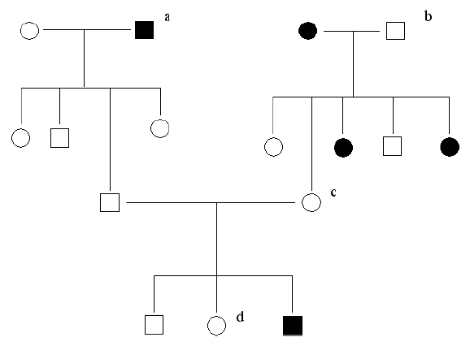
Members affected with Lung disease

Slide 40
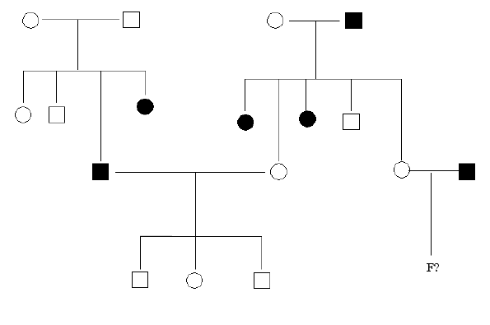
Members affected with Heart Disease

